Slide 1

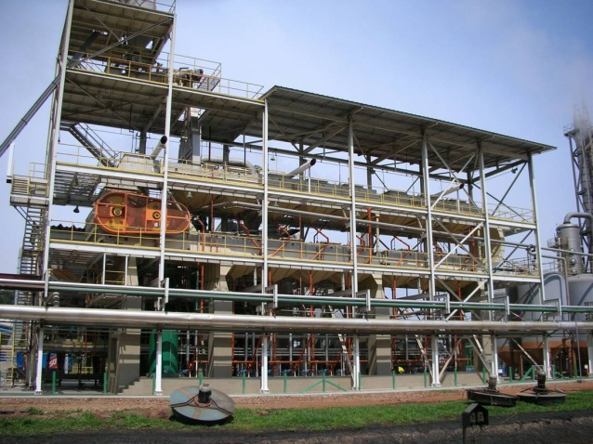
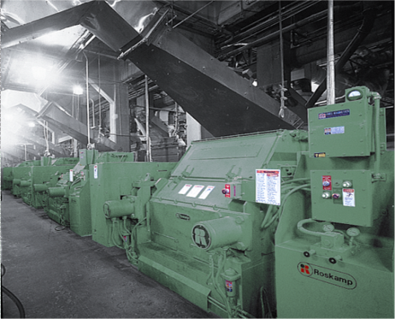
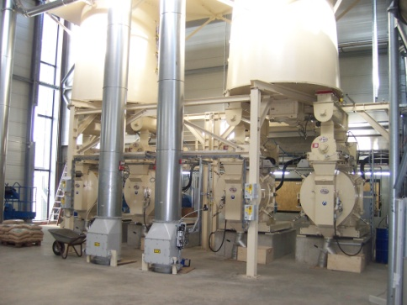
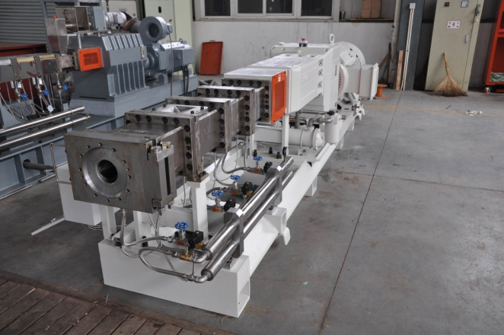
FEEDING THE WORLD’s growing appetite for advanced proteins, processed foods, engineered materials and bioenergy
PREMIER PROVIDER OF PROCESS EQUIPMENT AND ENGINEERED SYSTEMS
Company Overview
2019

Slide 2
CPM – Facts at a Glance
Leading supplier of process equipment and systems technology for the oilseed, animal feed, biofuel, human food and materials industries. Growth in these markets is driven by population and GDP growth which increases demands for advanced proteins, food, materials, and fuel.
Founded
1883 in San Francisco, California
Financial
2018 Revenues: ~$500MM
Employees
1260 (Americas 585, Asia 291, Europe 384)
Markets
Oilseed, Animal Feed, Bioenergy, Human Food, Engineered Materials, and Industrial
Facilities
25 facilities comprising of sales, engineering, manufacturing, and customer service centers in the Americas, Europe, and Asia

Slide 3
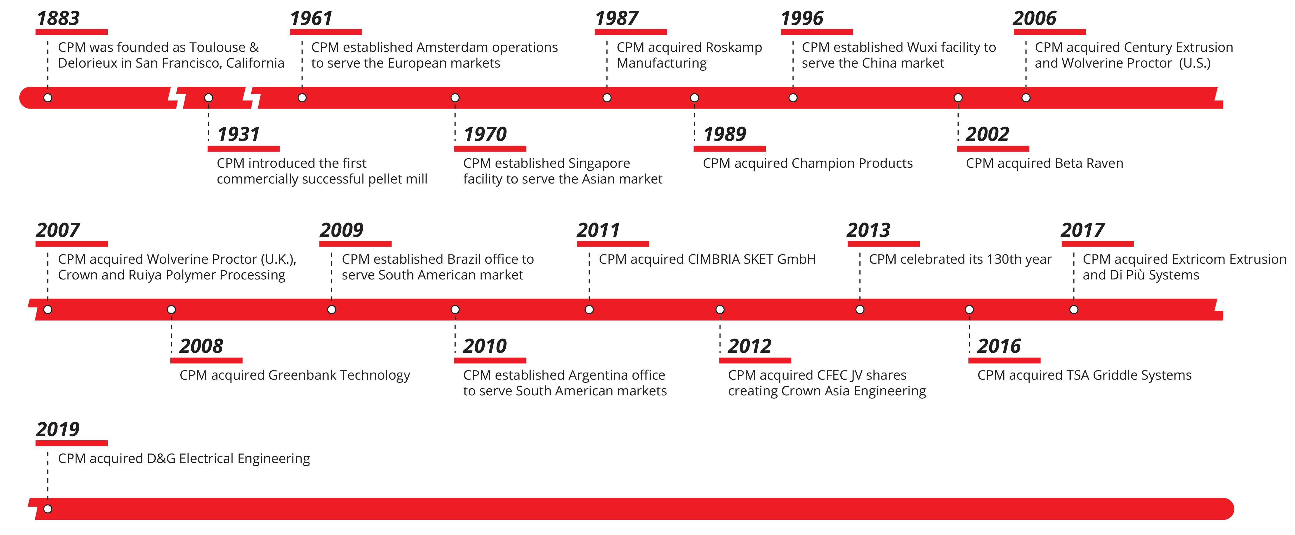
CPM History
CPM has a proud legacy of leadership and growth. Founded in 1883, CPM is committed to product, geographic and acquisitive growth in a relentless effort to exceed customer expectations.

Slide 4
CPM Leadership
CPM has a lean, empowered management team. Business Unit leaders exercise broad business unit autonomy in pursuit of aligned goals bound by integrity, values and passion for the business.
Ted Waitman
President & CEO
Years with Company: 40
President and Chief Executive Officer since 1996
Served various roles including manufacturing, plant and general management since 1978
Ted Waitman
President & CEO
Doug Ostrich
CFO
Nick Taiber
Corporate Development
Bill Antilla
Crown GM
Jim Hughes
CPM, Roskamp, WP GM
Maarten Visser
CPM-EU MD
Kent Chan
CPM-Asia MD
Bob Urtel
CPM Extrusion
CPM Metal
Bob McKay
Project Management
Organization Chart

Slide 5
CPM Advantage
  Provide customers premier operating equipment and services at the lowest total operating cost
  Industry best reliability and durability maximizing customer uptime
  Industry-leading product designs maximize energy efficiency and product quality
  Superior application knowledge and global presence
  Provide exceptional customer service and application/maintenance advice

Slide 6
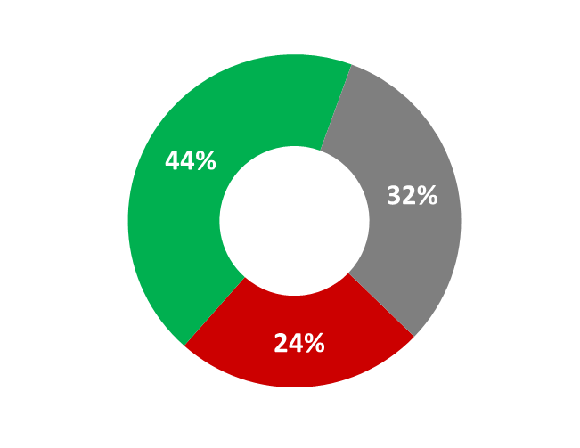
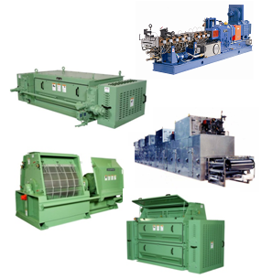
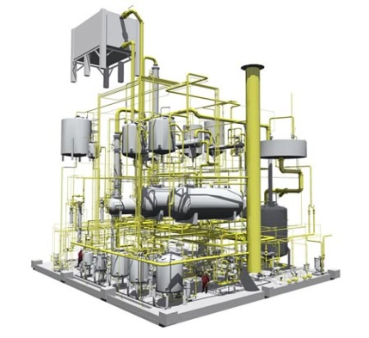
CPM Process Equipment and Engineered Systems
CPM provides comprehensive solutions through a unique combination of extensive design and engineering expertise and best-in-class proprietary equipment.
Proprietary Process Equipment
Engineered Systems
Pellet Mills
Flaking Mills
Roller Mills
Hammermills
Dryers
Extruders
Controls
Briquetters
Ovens
Extractors
Conditioners
Evaporators
DT/DC
Jet Dryers
Screw Presses
Conveyance
Designed and engineered process systems for many of the world’s largest and most sophisticated oilseed and biofuel facilities
World’s only scalable continuous pilot plant
Over 200 full-time engineers
Close interaction with customers’ engineering teams
Based on years of intellectual property and innovation
CPM “Lifecycle” Management
Proprietary Equipment
Aftermarket
Engineered Systems
% of FY2018 Revenue
1-1

Slide 7






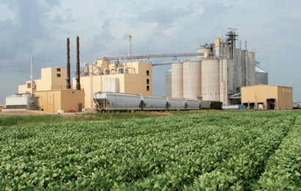






CPM Customers: Market Leading, Blue-Chip
CPM is a preferred partner to the world’s leading multinational oilseed, animal feed, and alternative energy processing companies.
CPM serves over 3,000 customers per year for systems, equipment, and after market support
“Embedded” relationships allow CPM to geographically expand into new markets in partnership with existing multinational customers
Representative Customers
1-5
Notes:
CPM has long standing relations as a preferred supplier to the worlds leading multinational oilseed, animal feed and bioenergy processors.
ADM, Cargill and Bunge control over 50% of the worlds oilseed processing technology. CPM enjoys a longstanding relationship with Cargill and ADM as almost an exclusive supplier for their processing plants worldwide. Bunge splits their business between CPM and our competition.
Color on Bunge
CPM is the preferred supplier of animal feed processing equipment to all large US based integrated poultry and pork producers.
And preferred supplier to many of the worlds leading biofuel producers

Slide 8
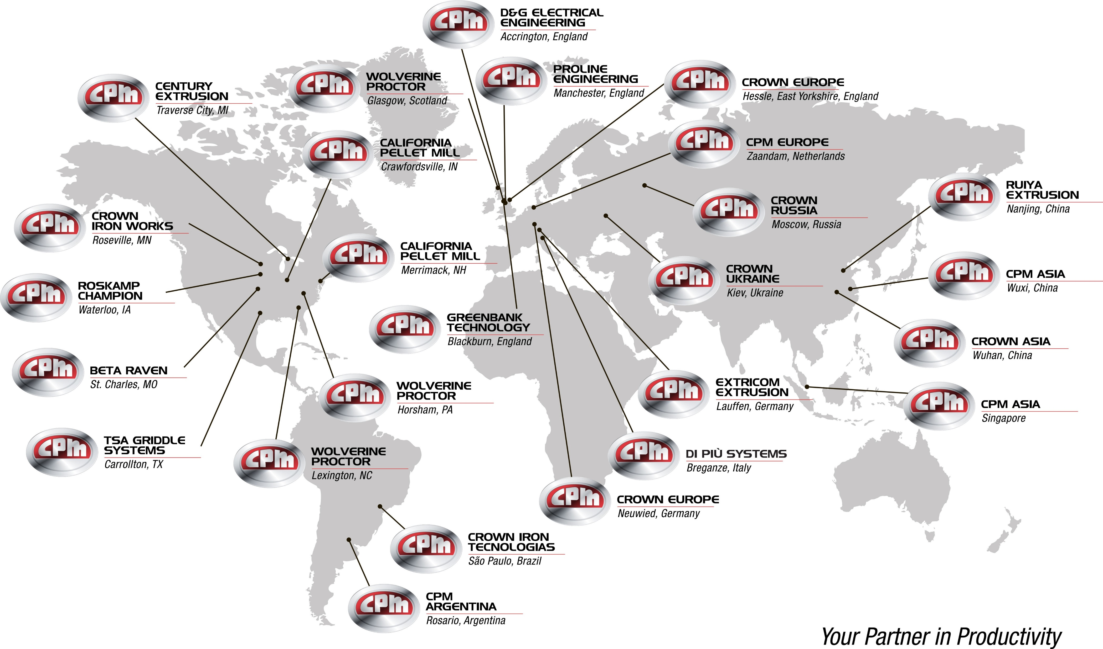
Worldwide Operations
Established global business with a long-standing presence in
North American, South American, European and Asian markets
Notes:
This shows the geographic footprint of CPM. 21 locations total. 10 of these are sales and engineering offices.
No competitor matches our global coverage and ability to serve the geographically important market areas
California Pellet Mill the original parent co. has 3 facilities in the US, 1 in Europe & 2 in Asia
All other locations are specific to acquired businesses and have enhanced our global coverage

Slide 9
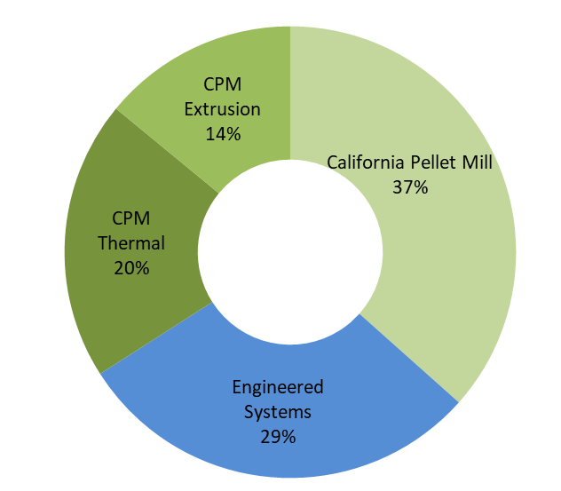
CPM Divisions
Business | Description
Beta Raven/D&G | Acquired in 2002 and based in St. Charles, MO, Beta Raven is a leading supplier of automation, controls, and dosing equipment to the feed, bakery, and all CPM applications. In 2019, CPM acquired D&G Electrical Engineering to serve as a Beta Raven-Europe platform.
California Pellet Mill | With five locations worldwide, California Pellet Mill is the worldwide leader in process machinery to the animal feed milling industry and other industrial pelleting applications.
Century Extrusion | Acquired in 2006 and based in Traverse City, MI, Century Extrusion is a leading supplier of twin screw extruder systems and replacement parts for the plastics industry.
Crown Irons Works | Acquired in 2007, based in Minneapolis, MN, Crown Iron Works is the world leader in oilseed processing technology and equipment in oilseed preparation, extraction, refining, oleochemical, biodiesel, and specialty extraction.
Di Più Systems | Acquired in 2017, based in Breganze, Italty, Di Più Systems is a world leader in biomass, metals and waste stream briquetting technologies featuring mechanical and hydraulic presses and ancillary equipment.
Extricom Extrusion | Acquired in 2017, based in Lauffen, Germany, Extricom is the world’s leader in ring and twin extrusion technologies. Extricom is also a leading aftermarket parts supplier for Europe
Greenbank Technology | Acquired in 2008 and based in Blackburn, UK, Greenbank Technology is the leader in two-piece can thermal processing and traditional market segments of paper/pulp, web, & textile.
Roskamp Champion | Acquired in 1987 and based in Waterloo, IA, Roskamp Champion is the world leader in material grinding and oilseed preparation equipment.
Proline Engineering | Acquired in 2017 and based in Manchester, UK, Proline is a leader in high-speed, high-volume conveyance systems the two-piece can market.
Ruiya Extrusion | Acquired in 2007 and based in Nanjing, China, Ruiya Extrusion is the second largest twin screw extrusion provider in China for the compounding industry.
SKET | Acquired in 2011 and based in Magdeburg, Germany, SKET is a leader in oilseed technologies including equipment, and turn-key project management.
TSA Griddle | Acquired in 2016 and based in Dallas, Texas, TSA is the leading griddle technology provider for ready-to-eat, batter-based breakfast and frozen food markets.
Wolverine Proctor | Acquired in 2006 and based in Horsham, PA, and Glasgow, Wolverine Proctor is a leader in value adding thermal processing for the cereal and snack food industries.
FY2018 Revenue by Division
Divisions
Engineered Systems: Crown and SKET
California Pellet Mill: California Pellet Mill, Roskamp Champion, Beta Raven\D&G, Di Più
CPM Thermal: Wolverine Proctor, TSA Griddle, Greenbank Technology, Proline
CPM Extrusion: Century Extrusion, Extricom Extrusion, Ruiya Extrusion
Fiscal Year Ending September 30, 2018.

Slide 10
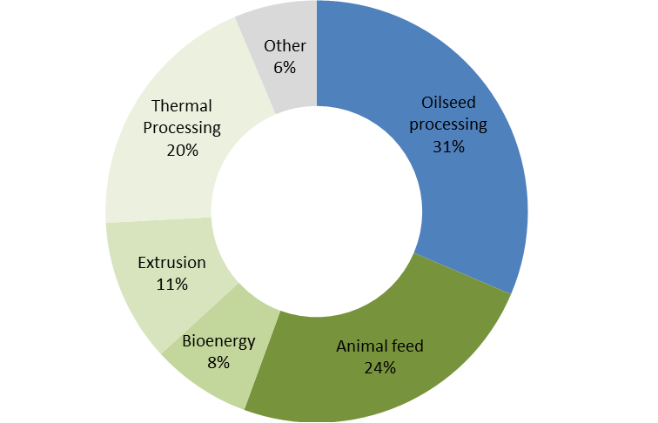
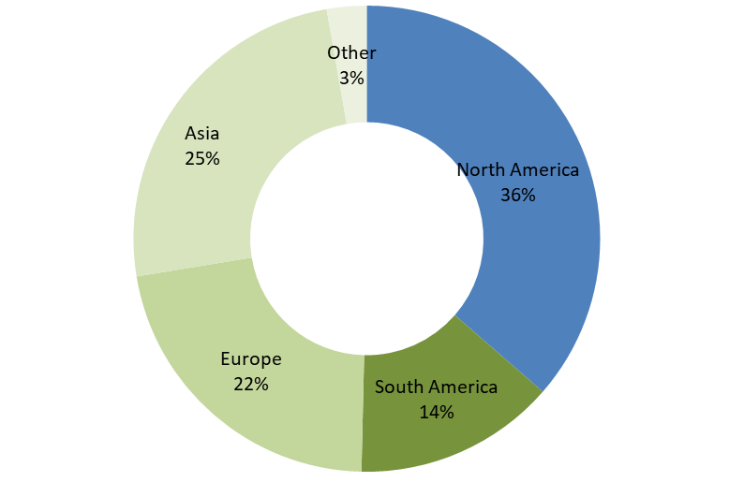
CPM Markets
Revenue by End Market
CPM Revenue by Geography
Fiscal Year Ending September 30, 2018.

Slide 11
Process Equipment and Engineered Systems Overview

Slide 12






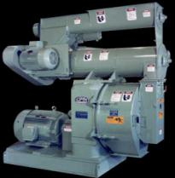
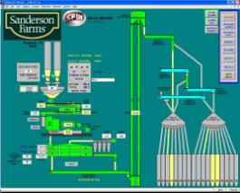
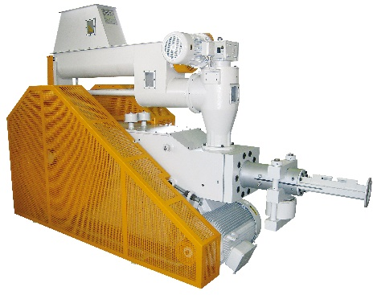
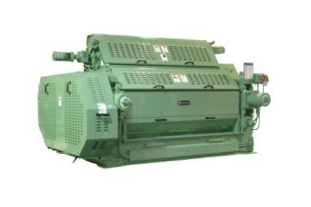
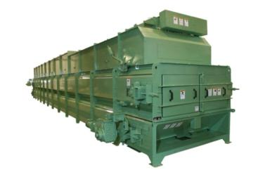
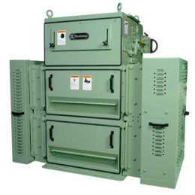
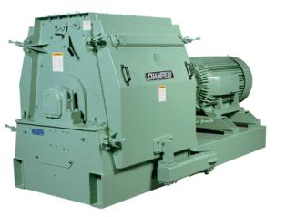
California Pellet Mill
Pellet Mills
Briquetters
Conditioners
Coolers
Flakers
Crackers
Hammer Mills
Roller Mills
Sifters/Screeners
Process Control & Automation
Scaling & Feeding Systems

Slide 13




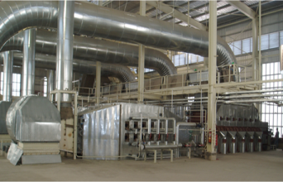
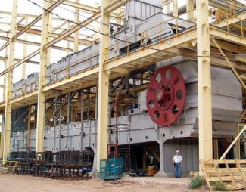
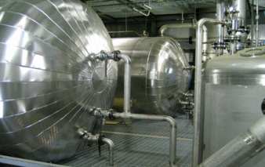
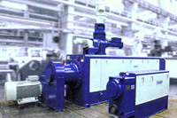
CPM Engineered Systems
Seed Preparation & Extraction
Hulloosenators
Aspirators
Extractors
Screw presses
Conditioners
Oil Refining
Degumming
Bleaching
Stripping & Deodorizing
Oleochemical & Biodiesel
Glycerin
Biodiesel systems
Specialty
Extraction
Flash dryer

Slide 14



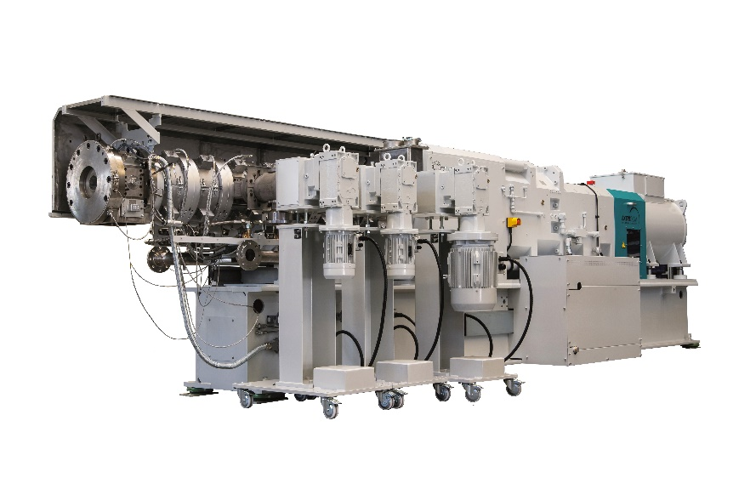
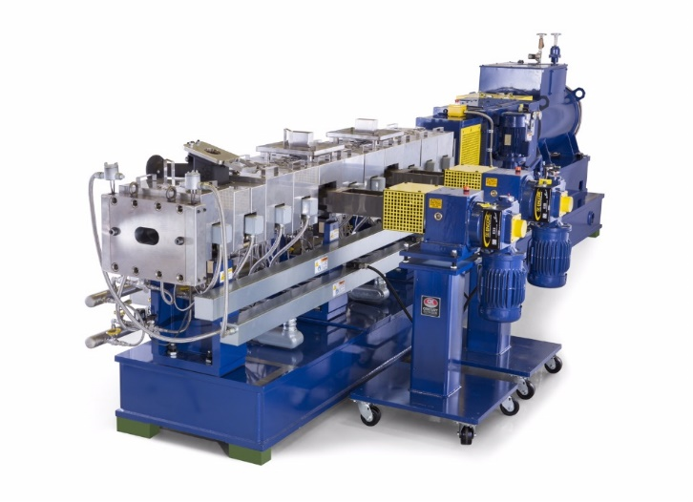
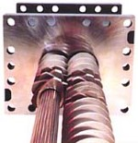
CPM Extrusion Group
  CPM Extrusion Systems
  Co and Multi-Screw processing technology
  Modular Extrusion Systems
  Unit machines – twin and ring
  Process control and automation
  Existing machine upgrades
  Plant optimization & debottlenecking
  Education & Training
  Supporting Technologies
  Side feeders
  Stand dies
  Wear parts
  Vacuum and cooling systems

Slide 15




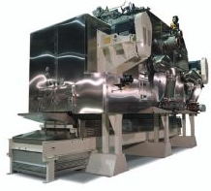
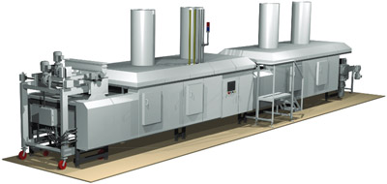
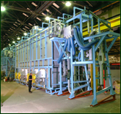
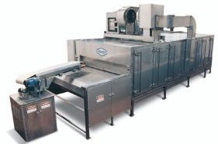
CPM Thermal Processing Group
Thermal Processing
  Fluidized bed Dryers
  Belt Dryers
  Roasters
  Toasters
  Coolers
  Metal decoration
  Griddles
  Conveyance
Preparation
  Pressure Cookers
  Flakers
  Shredders
  Batter Mixers

Slide 16
Sample MARKET AREAS
Addendum

Slide 17
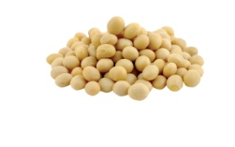
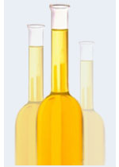
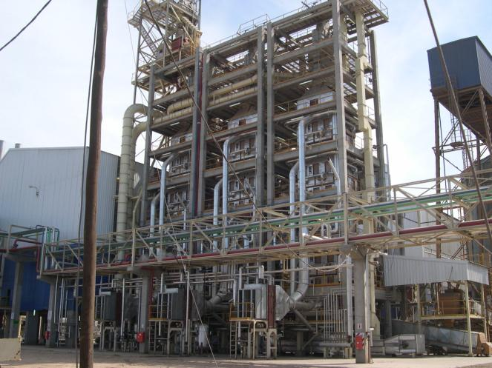
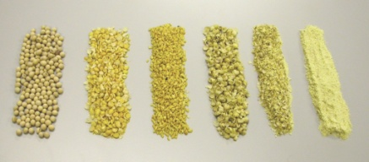
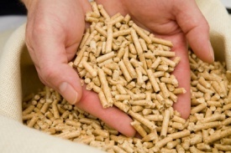
Oilseed
Oilseed Processing Facility
8.000 tons/day
Rosario, Argentina
Whole Beans
Screener
Roskamp Cracker
Crown Jet Dryer
Crown Aspirator
Project Narrative
New entrant into oilseed processing
Customer chose CPM/Crown to realize the process and equipment operating advantages to become a competitive, low-cost commodity producer
Project represents significant aftermarket opportunities for cracking roll, hammers, bearings, and more
Designed for facility expansion where CPM/Crown are the incumbent and preferred suppliers
Crown Vertical Seed Conditioner
Roskamp Flaking Mill
Flakes
Roskamp Hullosenator
Crown Extractor
Crown Aspirator
Crown Dryer Toaster
Desolventizer Cooler
Crude Oil
Meal
Screener
Champion Hammermill
Clean Beans
Hulls
Champion Hammermill
CPM Pellet Mill
Soybean During
Dehulling Process
Ground
Meal
CPM Counterflow Cooler
CPM Equipment
Non-Company Equipment
Pelleted Hulls
Crown Hot Dehulling System

Slide 18
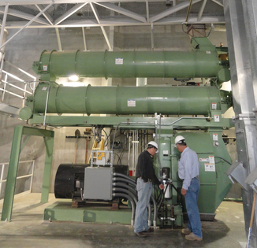
Animal Feed
Integrated Feed Facility
2,000 ton/day
Mississippi, United States
Whole Grain
Champion
Gyro Sifter
Project Narrative
Fully integrated poultry producer
30+ year CPM relationship
Designed around a new operating philosophy – a single pellet mill to achieve the absolute lowest total cost per ton of production. Made possible due to the durability, reliability, and productivity of the mill
Producer has standardized on Beta Raven automation systems
Meals
Champion
Hammermill Grinder
Beta Raven
Micro Ingredient System
Micro Ingredients
Mixer
Mash Feed
Beta Raven
Automation System
CPM
Feeder/Conditioner
Steam
CPM
Pellet Mill
Pelleted Feed
CPM
Horizontal Cooler
Cool/Dry Pellets
CPM
Pellet Crumbler
CPM Equipment
Crumbled Feed
Non-Company Equipment

Slide 19
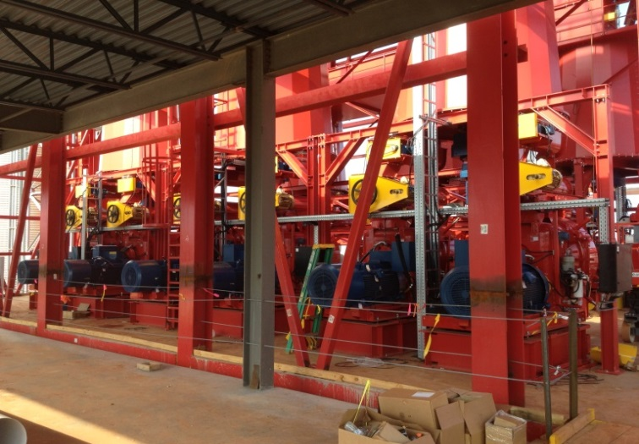
Biomass (solid biofuel pelleting)
Biomass Pelleting Facility
1,400 tons/day
Texas, United States
Waste Inputs
Drying
Champion Hammermil Grinding
Project Narrative
European customer expanding into southeastern US market where paper pulp tree farms are being repurposed into biomass feedstock
Leveraging European existing customer relationships
Made possible due to the durability, reliability , and productivity of the CPM system
12 pellet mills, 4 hammermills, and ancillary CPM equipment
CPM Conditioning
CPM Pellet Mills
CPM Cooling
Screening
Mixed Biomass
Sized Biomass
CPM Equipment
Non-Company Equipment

Slide 20

Compounding Systems
Unit Compounding Operation
Expanded Scope
Automotive Polyamide Compounds
Mexico
$1M – CX Extruder & BR Automation
$200K – Engineering
$8.27M – Expanded Scope
PA6 Plastic resin
Unloading, Silo storage
transfer & refill
Project Narrative
Global Producer of Chemicals and Polymers
20+ year CPM Century relationship
Complete design-supply-commission Scope of supply
End-to-end responsibility from Silo to packaged products
Siemens PLC systems, with Ignition Process Visualization
Gravimetric Ingredient Dosing
Additive Pre-blend Mixing
Multiple Ingredient Streams
Century
Twin screw extruder
Pelletizing
Beta Raven
Automation System
Strand Quench, Cutting
Pellet Cooling, Classification
Product QC
Product transfer,
QC storage bins
Product Packaging
Bag or Gaylord Box Loading
PA6 Automotive Compounds
CPM Equipment
Non-Company Equipment

